Slide 1







Customer Feedback Analysis and Improvement

Slide 2
Instructor: Eng Abdelrahman Elmashtoly
Members:
Yousef Sherif
Menna Essam
Rahma Shindy
Zeyad Hussein
Mahmoud Ahmed

Slide 3
Project Overview
Objective:
The primary goal of this project was to analyze customer feedback to identify trends, classify sentiment, and provide actionable insights to improve customer experience.

Slide 4

Database

Slide 5
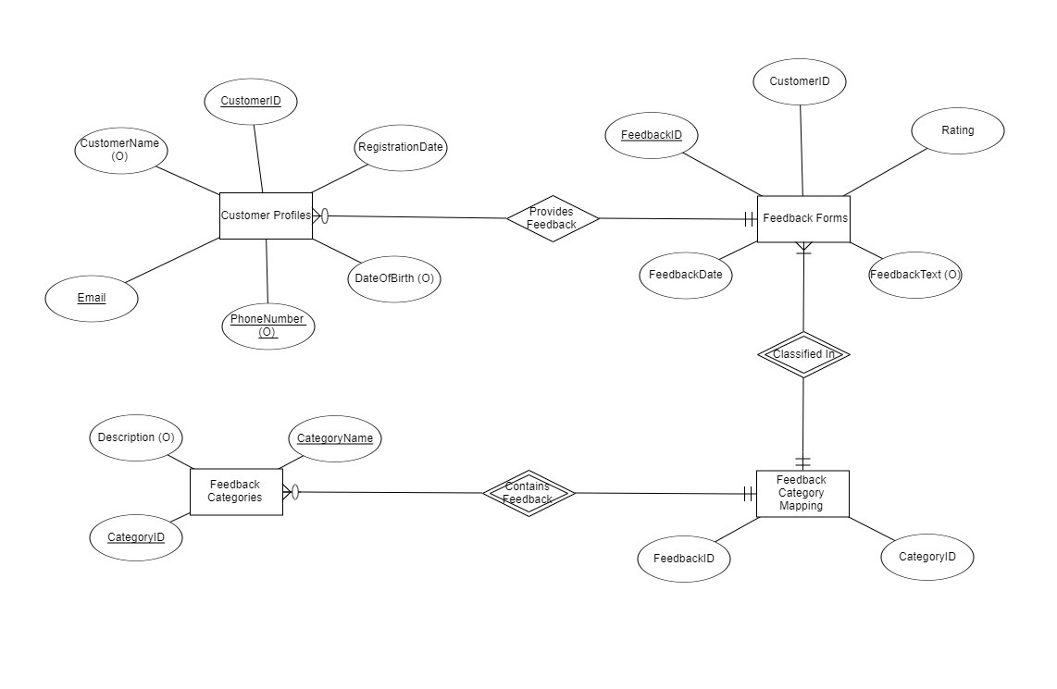
ERD Diagram

Slide 6
Customers Table:
CustomerID: This column uniquely identifies each customer and serves as the primary key.
It automatically generates a new value for each customer added to the table, ensuring no duplicates.
CustomerName: This column contains the name of the customer, allowing for the storage of full names with
support for different languages and special characters.
Email: This column stores the customer's email address, providing a way to record their primary
communication method for contact purposes.
Phone: This column captures the customer's phone number, enabling the storage of their contact number,
including any country codes or special formatting.

Slide 7
Feedback Categories Table:
CategoryID: This is the primary key that uniquely identifies each feedback category. It automatically
generates a new, unique value for each category entered into the table, ensuring no duplicate categories.
CategoryName: This column stores the name or description of each feedback category, allowing for
a clear understanding and classification of feedback types.

Slide 8
Feedback Forms Table:
FormID: This column serves as the primary key, uniquely identifying each feedback form. It automatically generates
a new, unique identifier for every form entered, preventing duplicate entries.
CustomerID: This column links each feedback form to a specific customer, enabling the tracking of which customer
submitted the form.
FormDate: This column records the date and time when the feedback form was submitted, providing a timestamp
for each entry.

Slide 9
Feedback Table:
FeedbackID: This column acts as the primary key, uniquely identifying each piece of feedback. It automatically
generates a new identifier for every feedback entry, ensuring uniqueness.
FormID: This column links each feedback entry to a specific feedback form, allowing for easy tracking of which
form the feedback is associated with.
CategoryID: This column connects the feedback to a particular category, enabling classification and organization
based on the type of feedback given.
Rating: This column captures the customer's rating of the feedback, constrained to a range between 1 and 5.
This ensures that only valid ratings are recorded.
Comments: This column allows for the storage of additional textual feedback from customers, providing a space
for detailed opinions or suggestions.

Slide 10
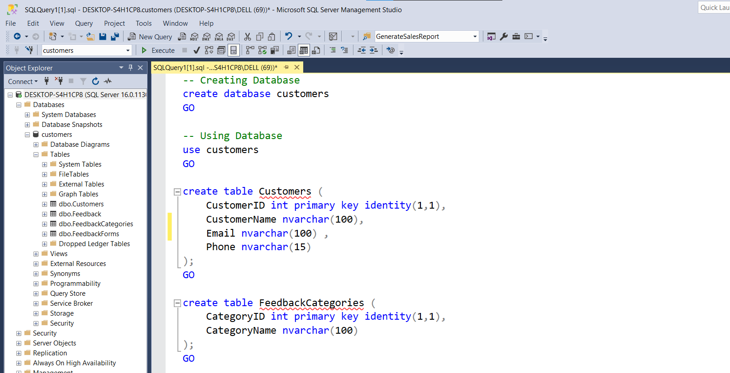

Slide 11
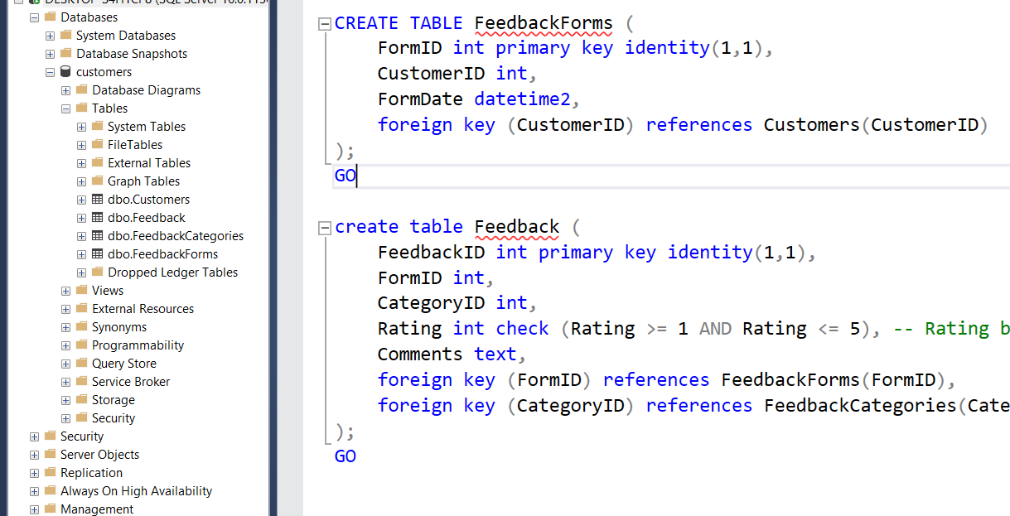

Slide 12
Quries for Feedback And Analysis

Slide 13
First Query:
-- Overall Customer Satisfaction (Get the average rating from all feedback entries) :
SELECT AVG(Rating) AS AverageRating
FROM Feedback;

Slide 14
Second Query:
-- Feedback Count by Category (Count the number of feedback entries for each category) :
SELECT fc.CategoryName, COUNT(f.FeedbackID) AS FeedbackCount
FROM Feedback f
JOIN FeedbackCategories fc ON f.CategoryID = fc.CategoryID
GROUP BY fc.CategoryName;

Slide 15
Third Query:
-- Average Rating by Category (Calculate the average rating for each feedback category) :
SELECT fc.CategoryName, AVG(f.Rating) AS AverageRating
FROM Feedback f
JOIN FeedbackCategories fc ON f.CategoryID = fc.CategoryID
GROUP BY fc.CategoryName;

Slide 16
Fourth Query:
-- Customer Feedback Summary (Get a summary report of feedback ratings from each customer):
SELECT c.CustomerName, AVG(f.Rating) AS AverageRating, COUNT(f.FeedbackID) AS FeedbackCount
FROM Customers c
JOIN FeedbackForms ff ON c.CustomerID = ff.CustomerID
JOIN Feedback f ON ff.FormID = f.FormID
GROUP BY c.CustomerName;

Slide 17
Fifth Query:
-- Detailed Feedback Records (Retrieve all feedback records along with customer names and category names):
SELECT c.CustomerName, fc.CategoryName, f.Rating, f.Comments, ff.FormDate
FROM Feedback f
JOIN FeedbackForms ff ON f.FormID = ff.FormID
JOIN Customers c ON ff.CustomerID = c.CustomerID
JOIN FeedbackCategories fc ON f.CategoryID = fc.CategoryID
ORDER BY ff.FormDate DESC;

Slide 18
Sixth Query:
-- Feedback Trends Over Time (Average Ratings Daily):
SELECT CAST(f.FormDate AS DATE) AS FeedbackDate,AVG(fb.Rating) AS AverageRating
FROM Feedback fb
JOIN FeedbackForms f ON fb.FormID = f.FormID
GROUP BY CAST(f.FormDate AS DATE)
ORDER BY FeedbackDate;

Slide 19
Seventh Query:
-- Most Common Feedback Comments (Frequently Mentioned Keywords):
SELECT SUM(CASE WHEN Comments LIKE '%improvement%' THEN 1 ELSE 0 END) AS ImprovementCount,
SUM(CASE WHEN Comments LIKE '%slow%' THEN 1 ELSE 0 END) AS SlowCount,
SUM(CASE WHEN Comments LIKE '%support%' THEN 1 ELSE 0 END) AS SupportCount,
SUM(CASE WHEN Comments LIKE '%Good%' THEN 1 ELSE 0 END) AS GoodCount
FROM Feedback;

Slide 20
Eighth Query:
-- Feedback Ratings Distribution (Count of Each Rating from 1 to 5):
SELECT Rating, COUNT(*) AS RatingCount
FROM Feedback
GROUP BY Rating
ORDER BY Rating;

Slide 21
Ninth Query:
-- Customers with Feedback Issues (Low Ratings of 1 or 2):
SELECT c.CustomerID, c.CustomerName, c.Email, fb.Rating
FROM Feedback fb
JOIN FeedbackForms ff ON fb.FormID = ff.FormID
JOIN Customers c ON ff.CustomerID = c.CustomerID
WHERE fb.Rating IN (1, 2);

Slide 22
Tenth Query:
-- Feedback Improvement Suggestions (Count of Comments Suggesting Improvements):
SELECT COUNT(*) AS ImprovementSuggestions
FROM Feedback
WHERE Comments LIKE '%improve%'
OR Comments LIKE '%better%'
OR Comments LIKE '%suggest%';

Slide 23

Data Warehouse

Slide 24
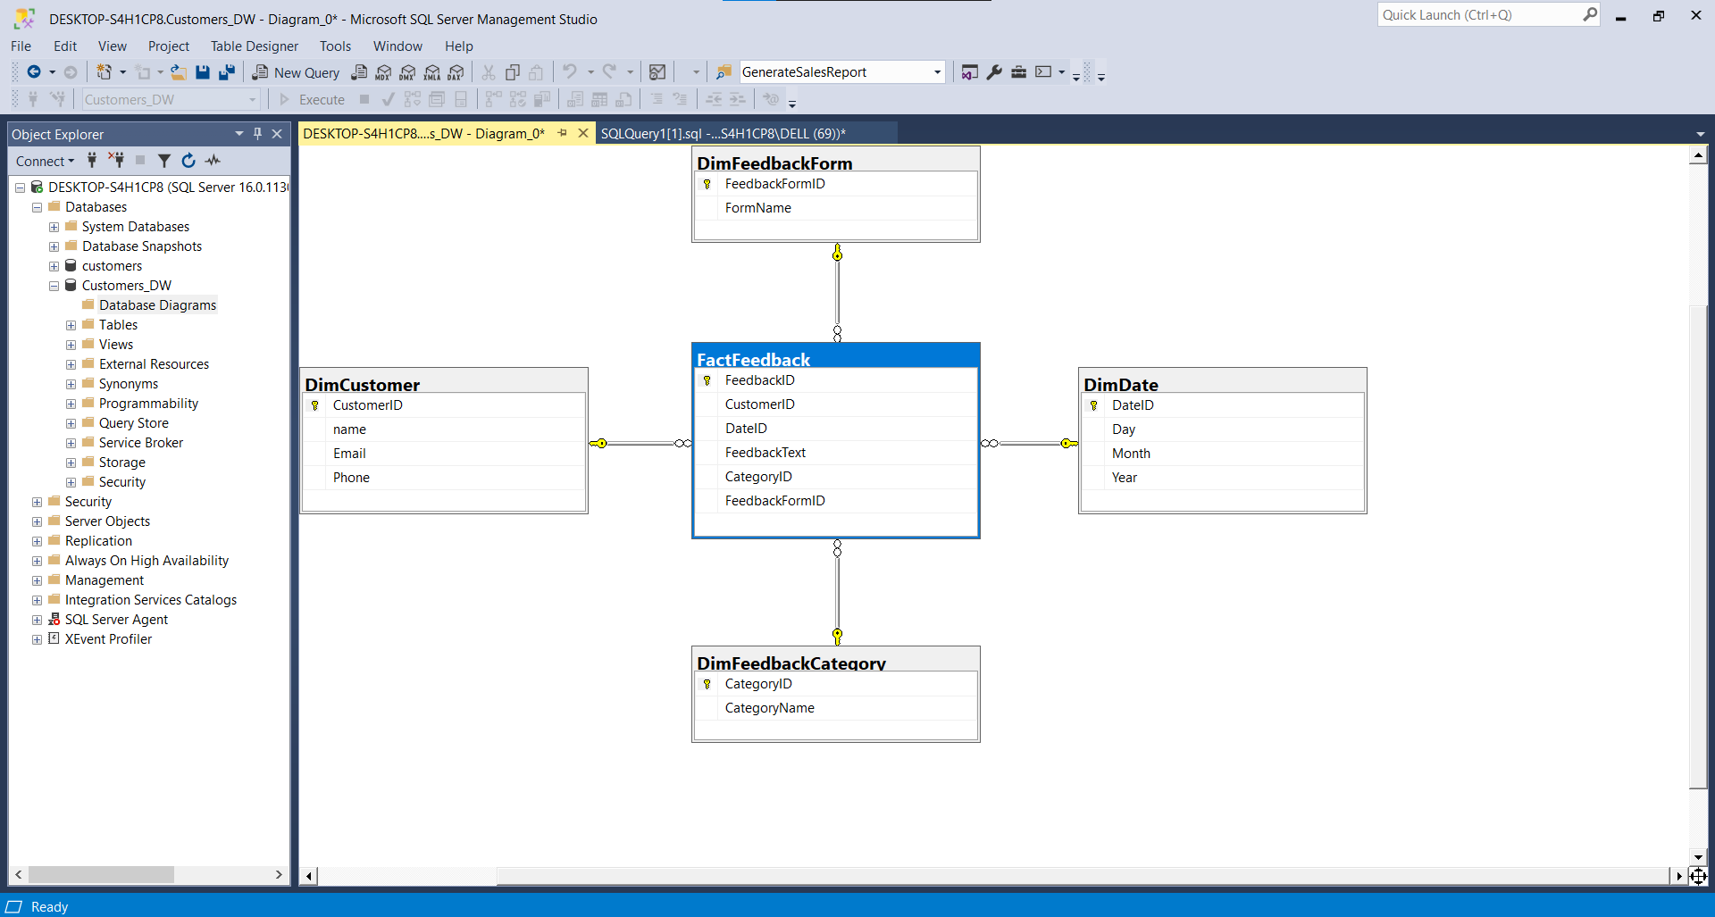

Slide 25
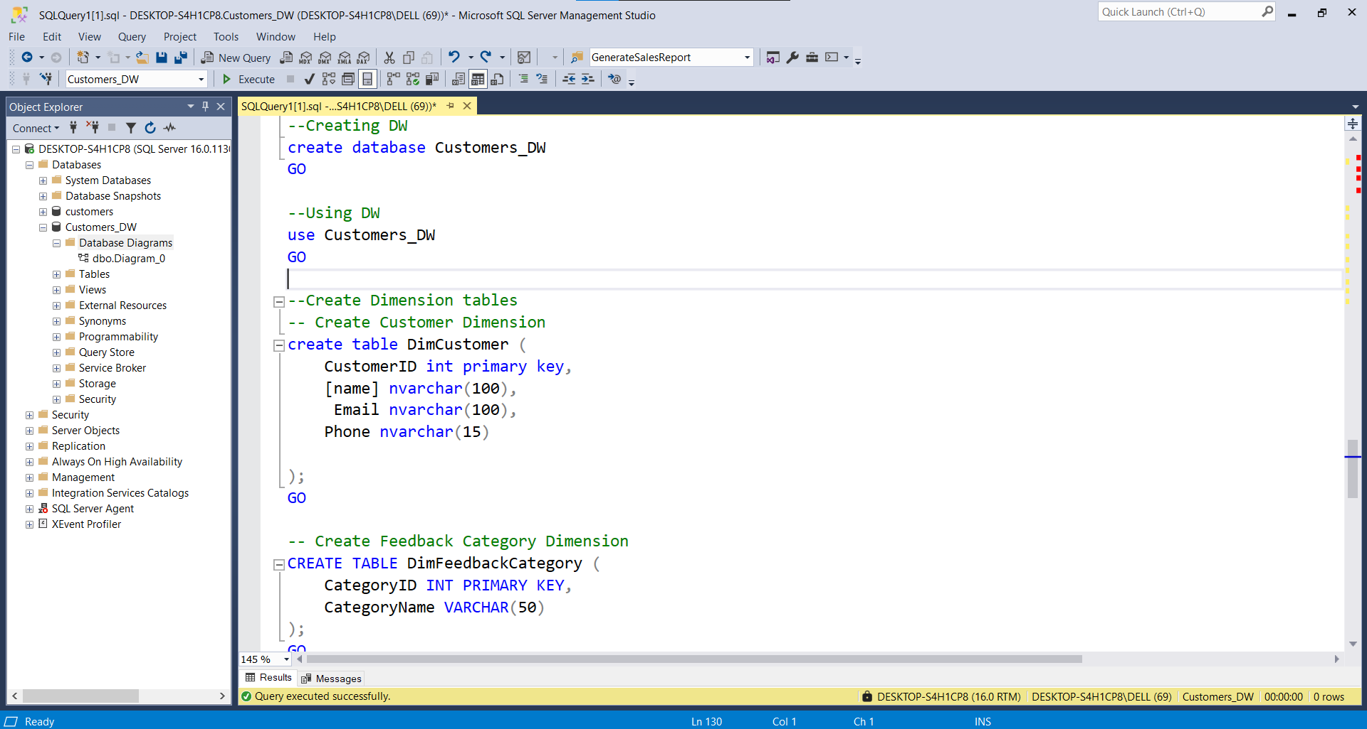

Slide 26
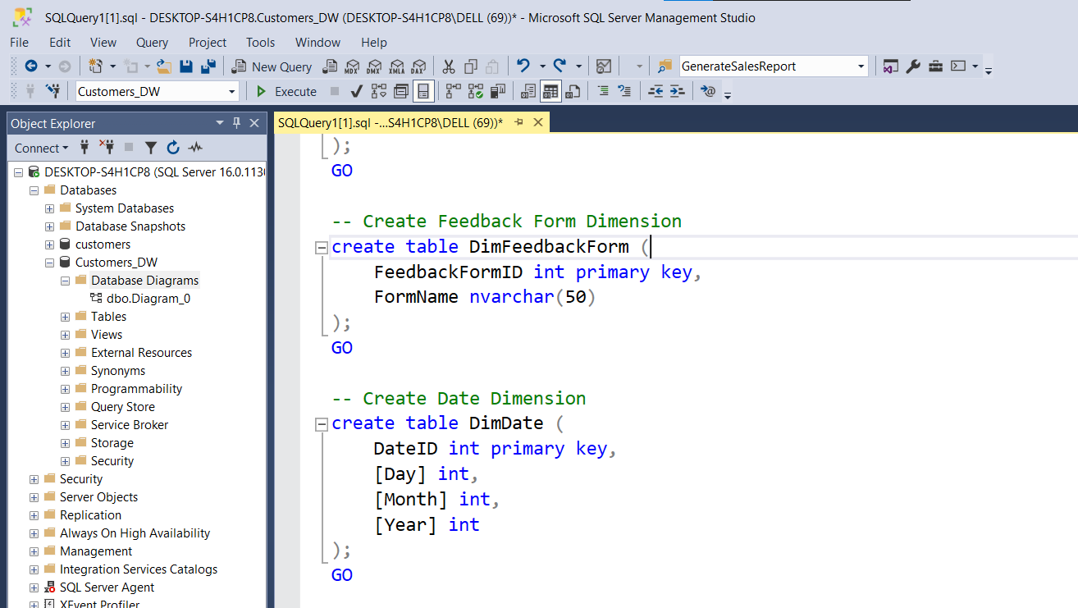

Slide 27
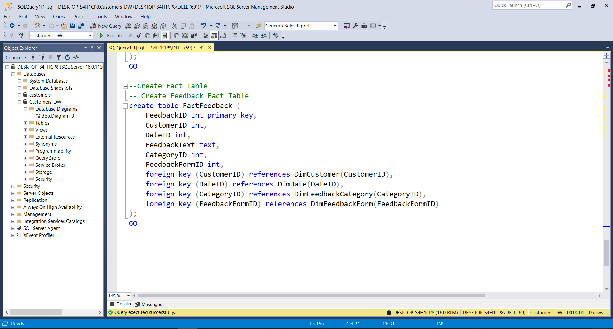

Slide 28

Python

Slide 29
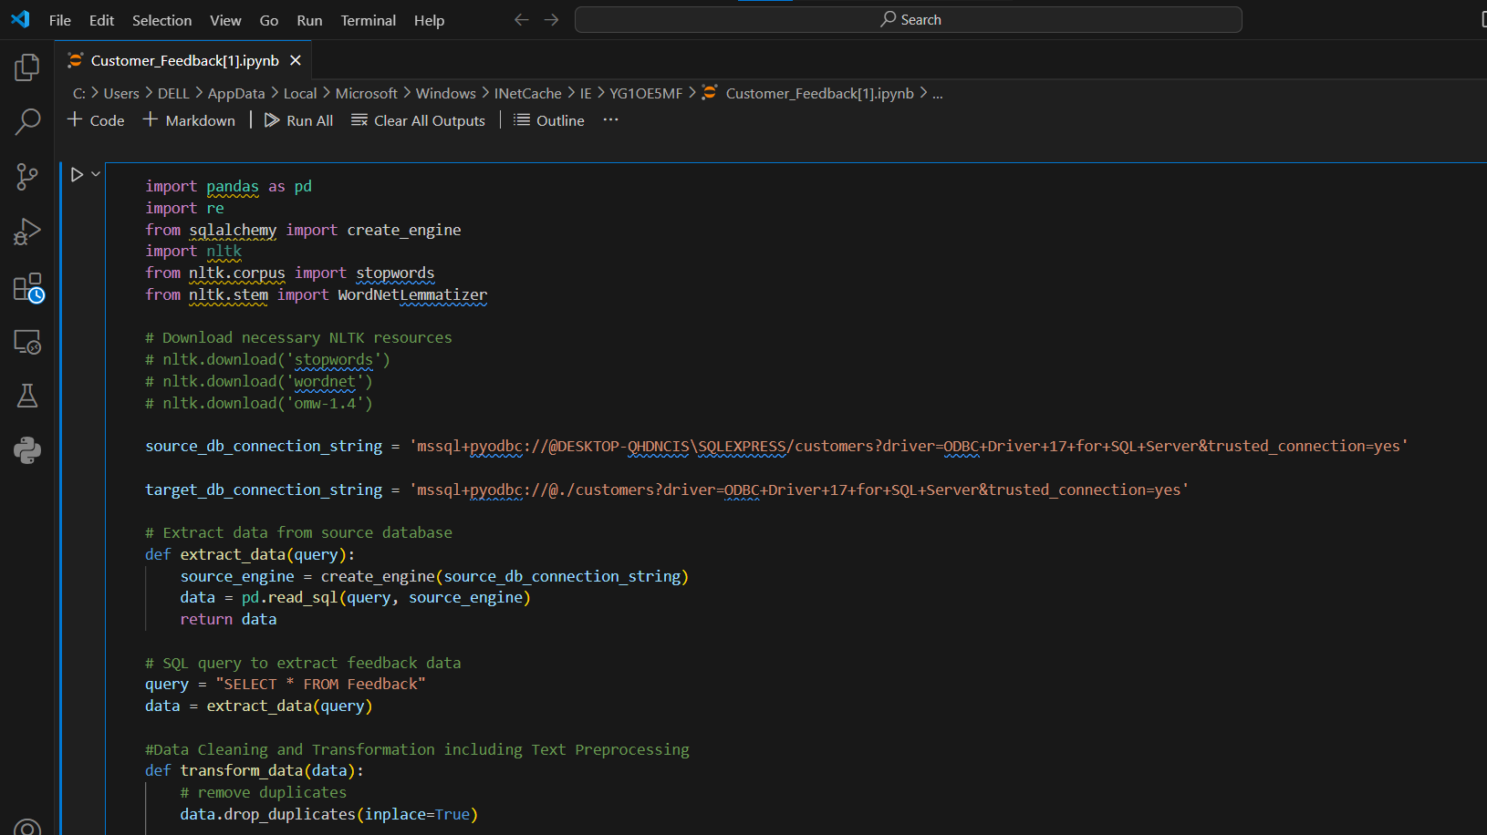

Slide 30
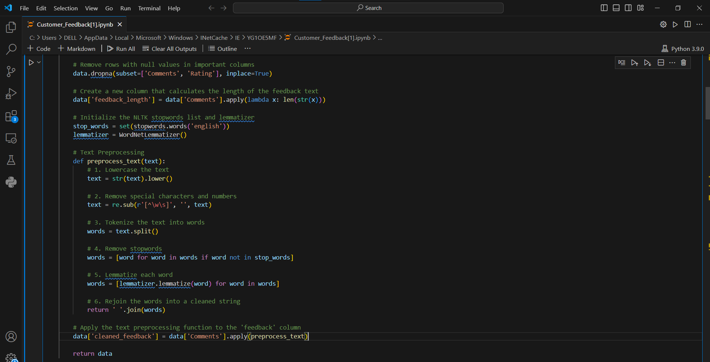

Slide 31
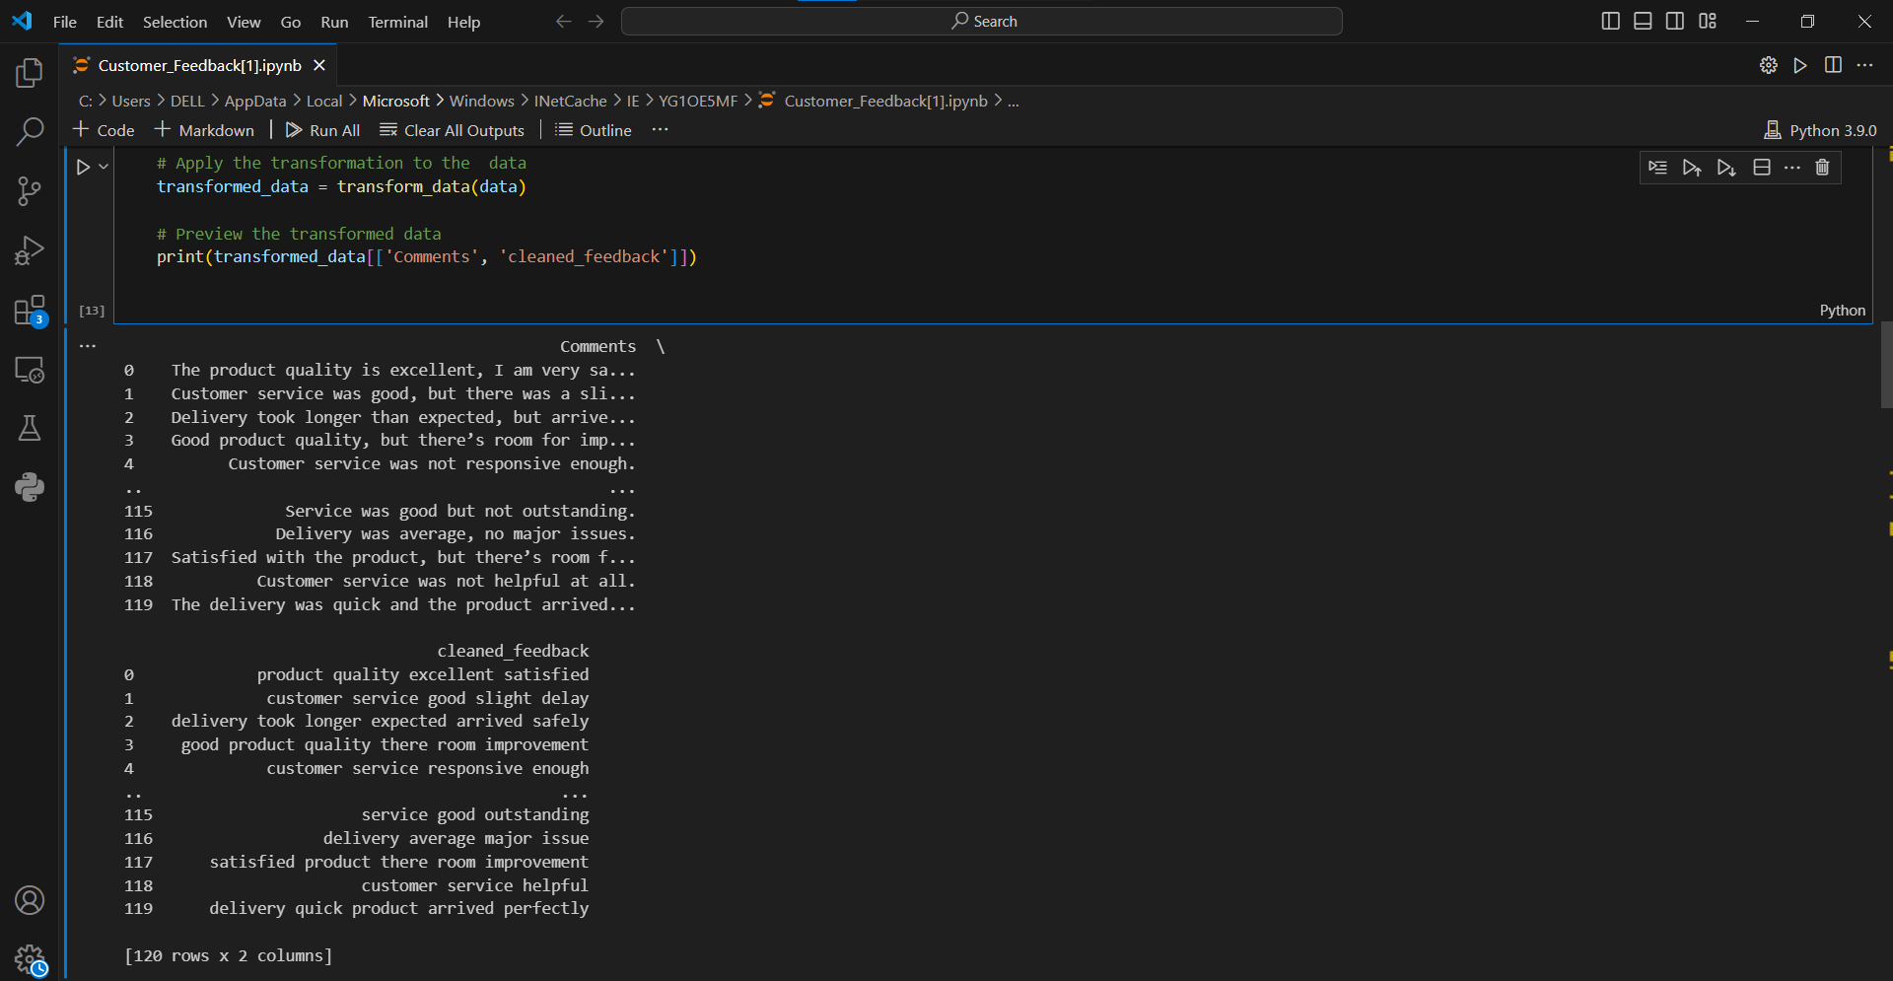

Slide 32
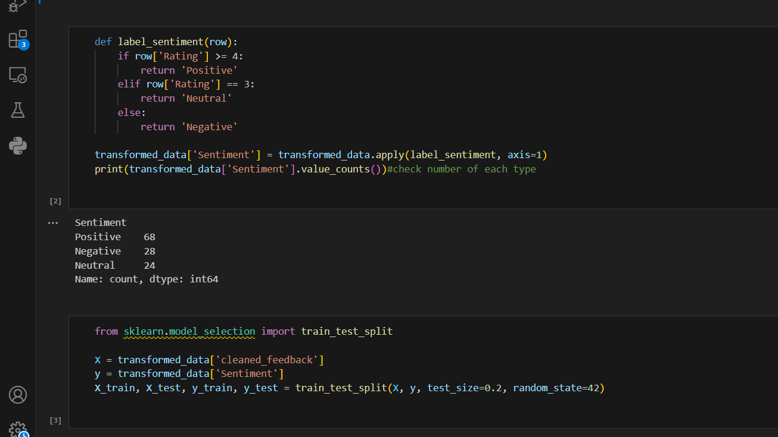

Slide 33
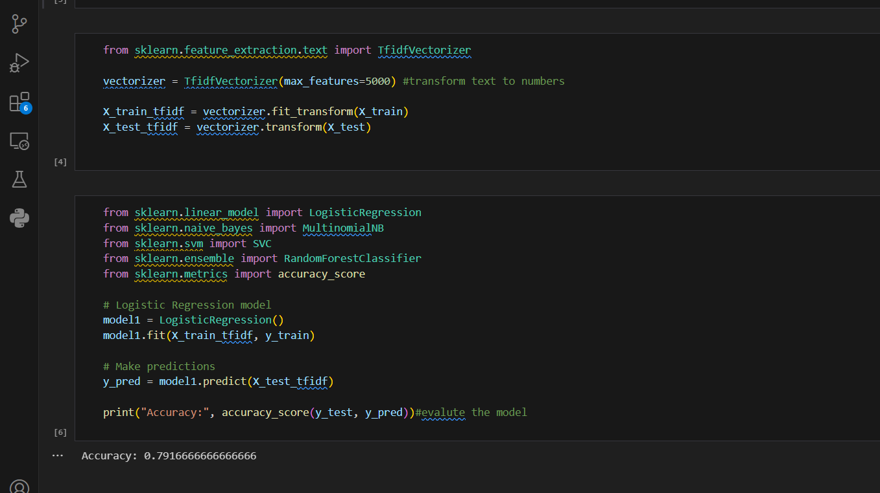

Slide 34
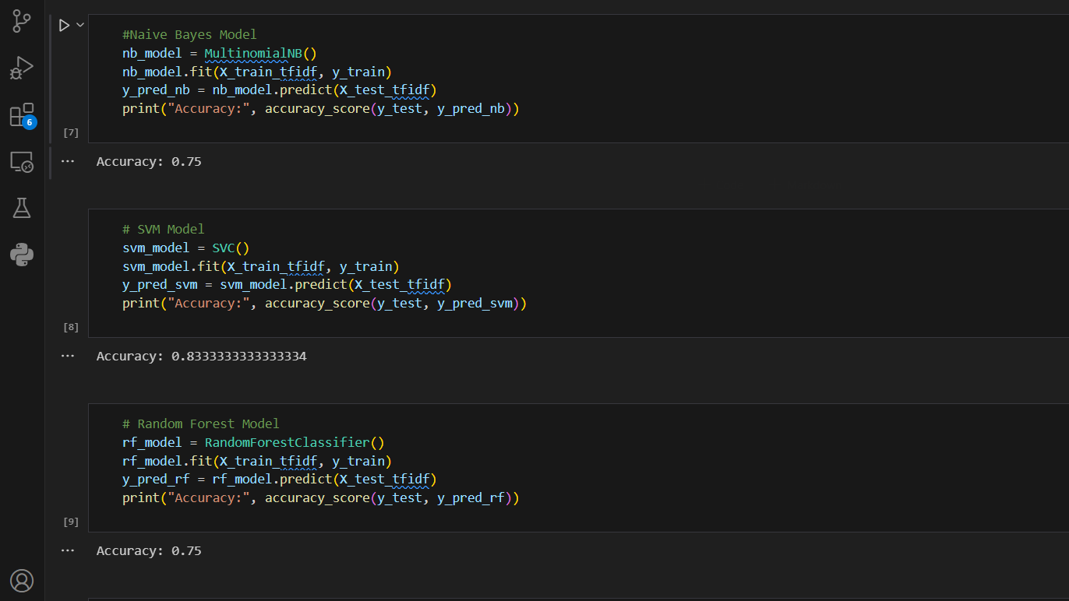

Slide 35
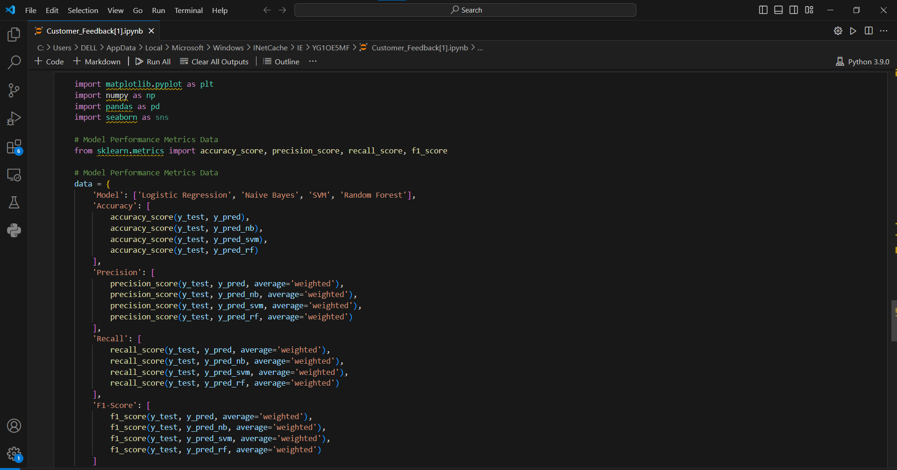

Slide 36
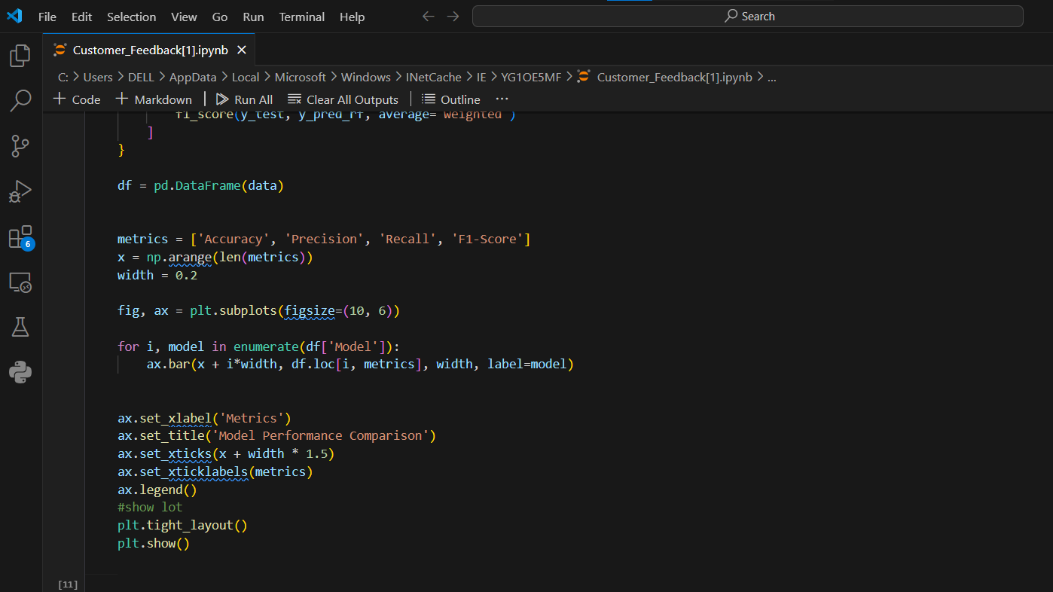

Slide 37
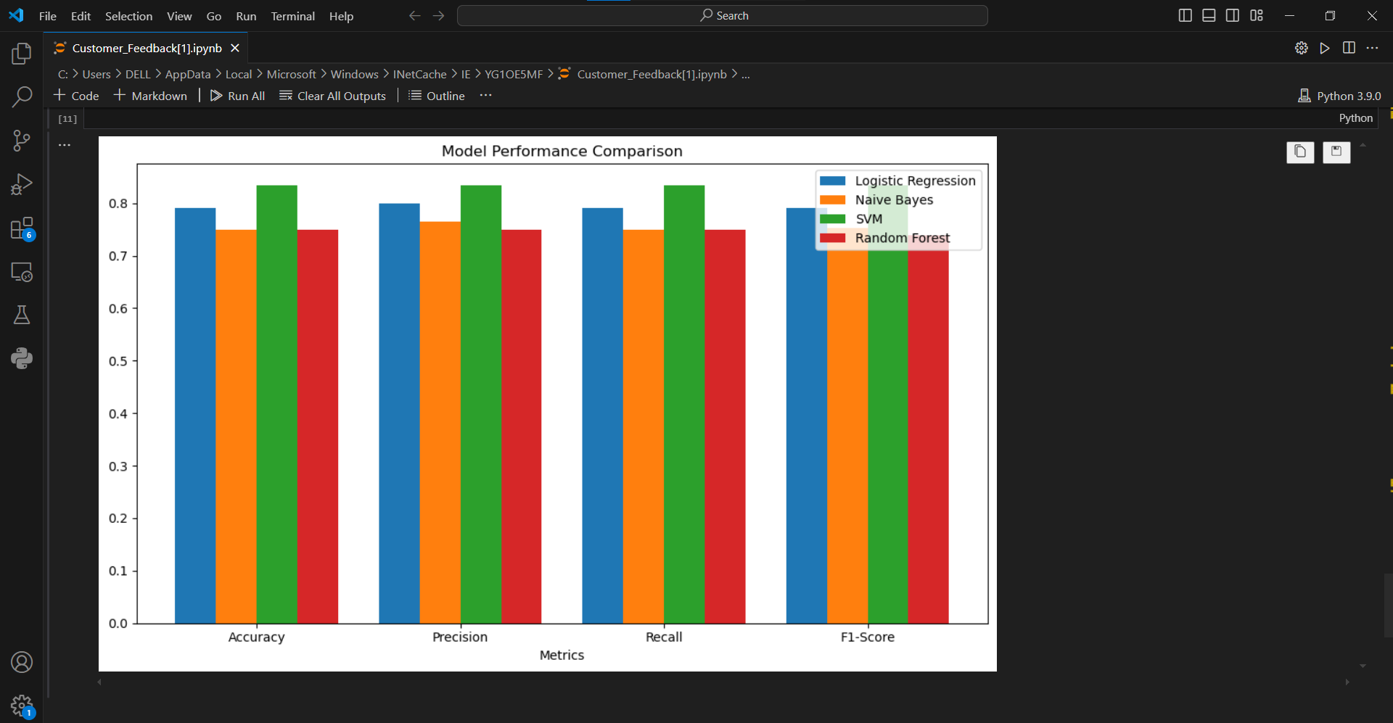

Slide 38
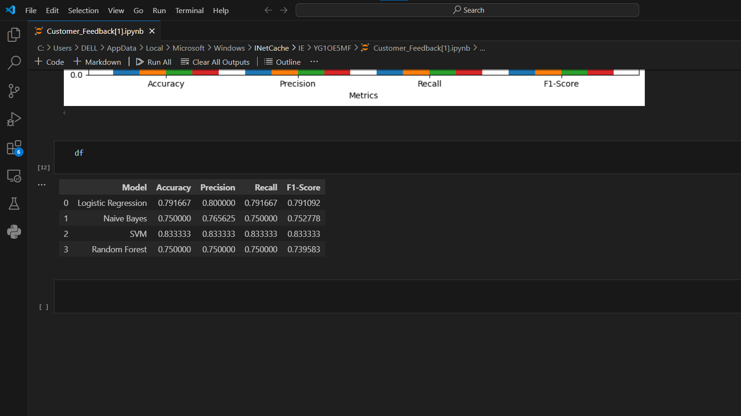

Slide 39
Power Bi

Slide 40
